Slide 1

Weekly Market Report
Friday, April 19, 2019
By: Jack Stubblefield

Slide 2
Benchmark Prices as of Market Close: 4/18/19
Benchmark | Ticker | Price | Yesterday’s Price Change
Dow Jones Industrial Average | ^DJI | 26,559.54 | +110.00 (0.42%)
S&P 500 | ^GSPC | 2,905.03 | +4.58 (0.16%)
NASDAQ Composite | ^IXIC | 7,998.06 | +1.98 (0.02%)
Russell 3000 Value Index | ^RAV | 1,634.33 | +0.35 (0.02%)
CBOE Volatility Index | ^VIX | 12.09 | -0.51 (-4.05%)

Slide 3
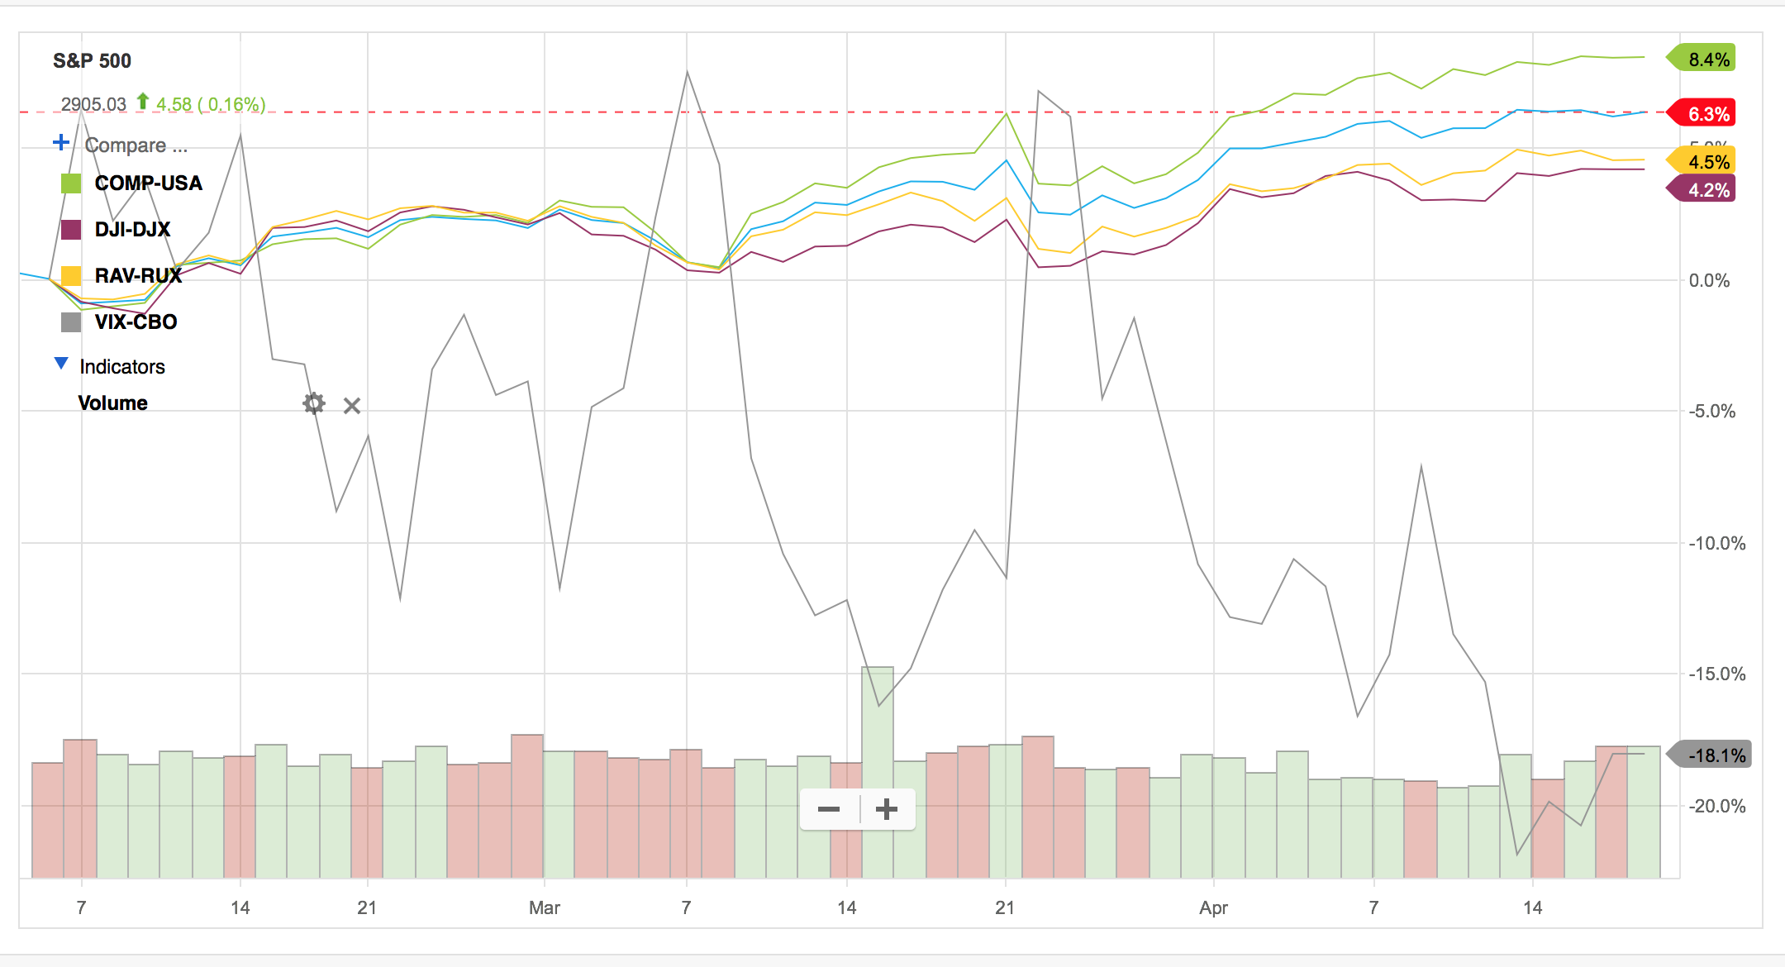
Benchmark Performance 3/6/19 – 4/18/19
From FactSet

Slide 4
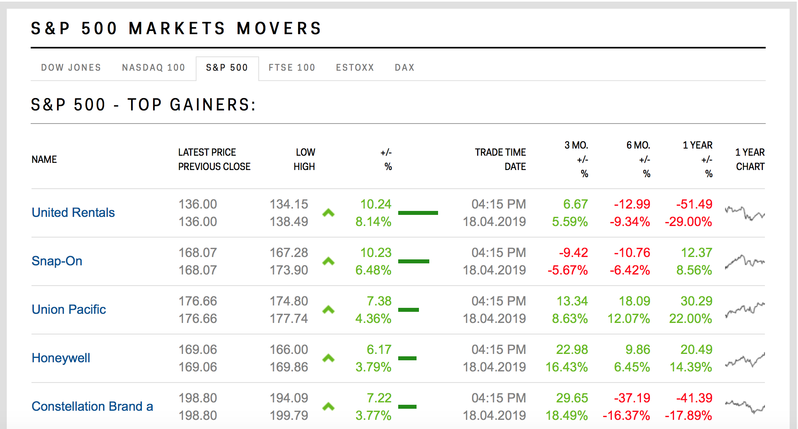
S&P 500 Winners of the Day
Industrials: United Rentals, Snap On, Union Pacific, Honeywell
Consumer Staples: Constellation

Slide 5
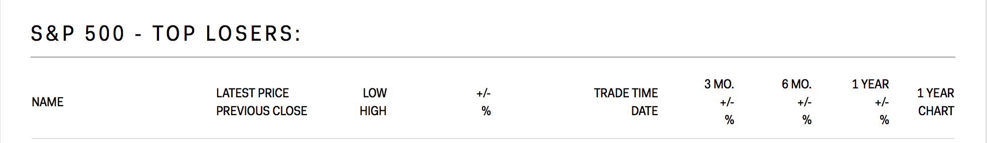
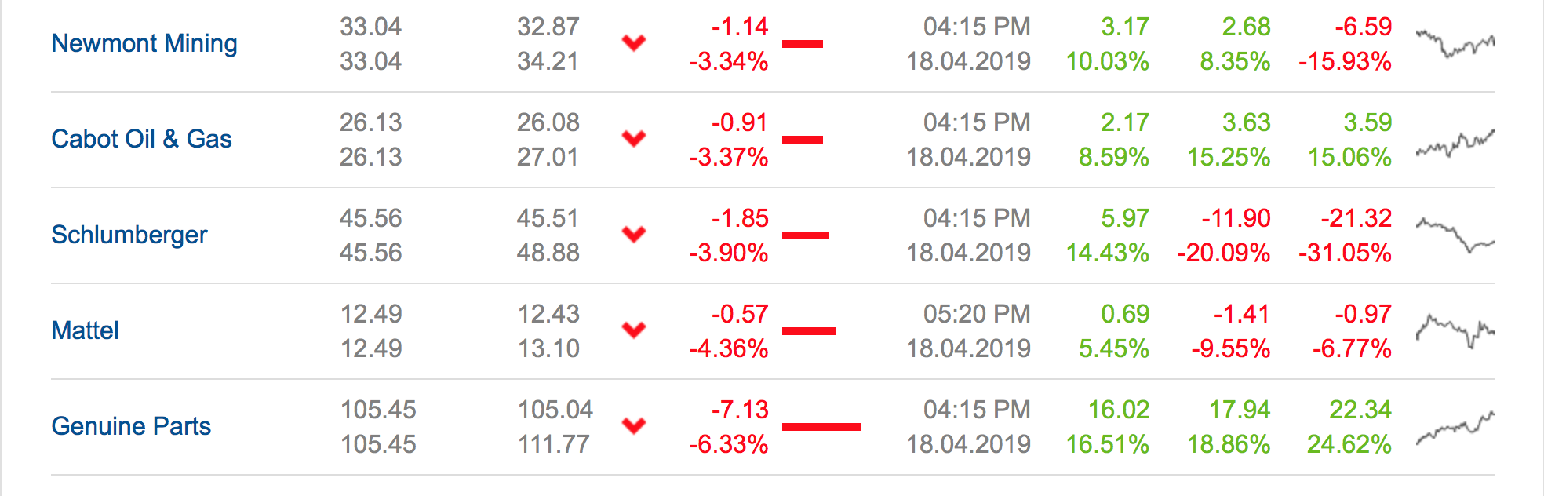
S&P 500 Losers of the Day
Materials: Newmont Mining
Energy: Cabot Oil & Gas, Schlumberger
Consumer Discretionary: Mattel
Industrial: Genuine Parts

Slide 6
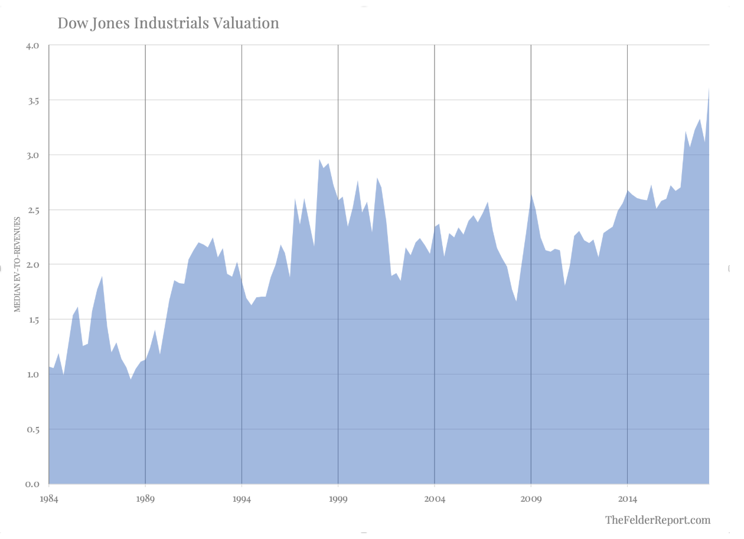
Market Watch Article
Price Insensitive Buying Has Led to This Troubling Chart
Median valuation of all stocks in DJI at 20% higher than peak of dot-com

Slide 7
CNBC Article
https://www.marketwatch.com/story/two-thirds-of-american-cfos-predict-a-recession-by-the-summer-of-2020-survey-finds-2019-04-17?mod=mw_theo_homepage

Slide 8
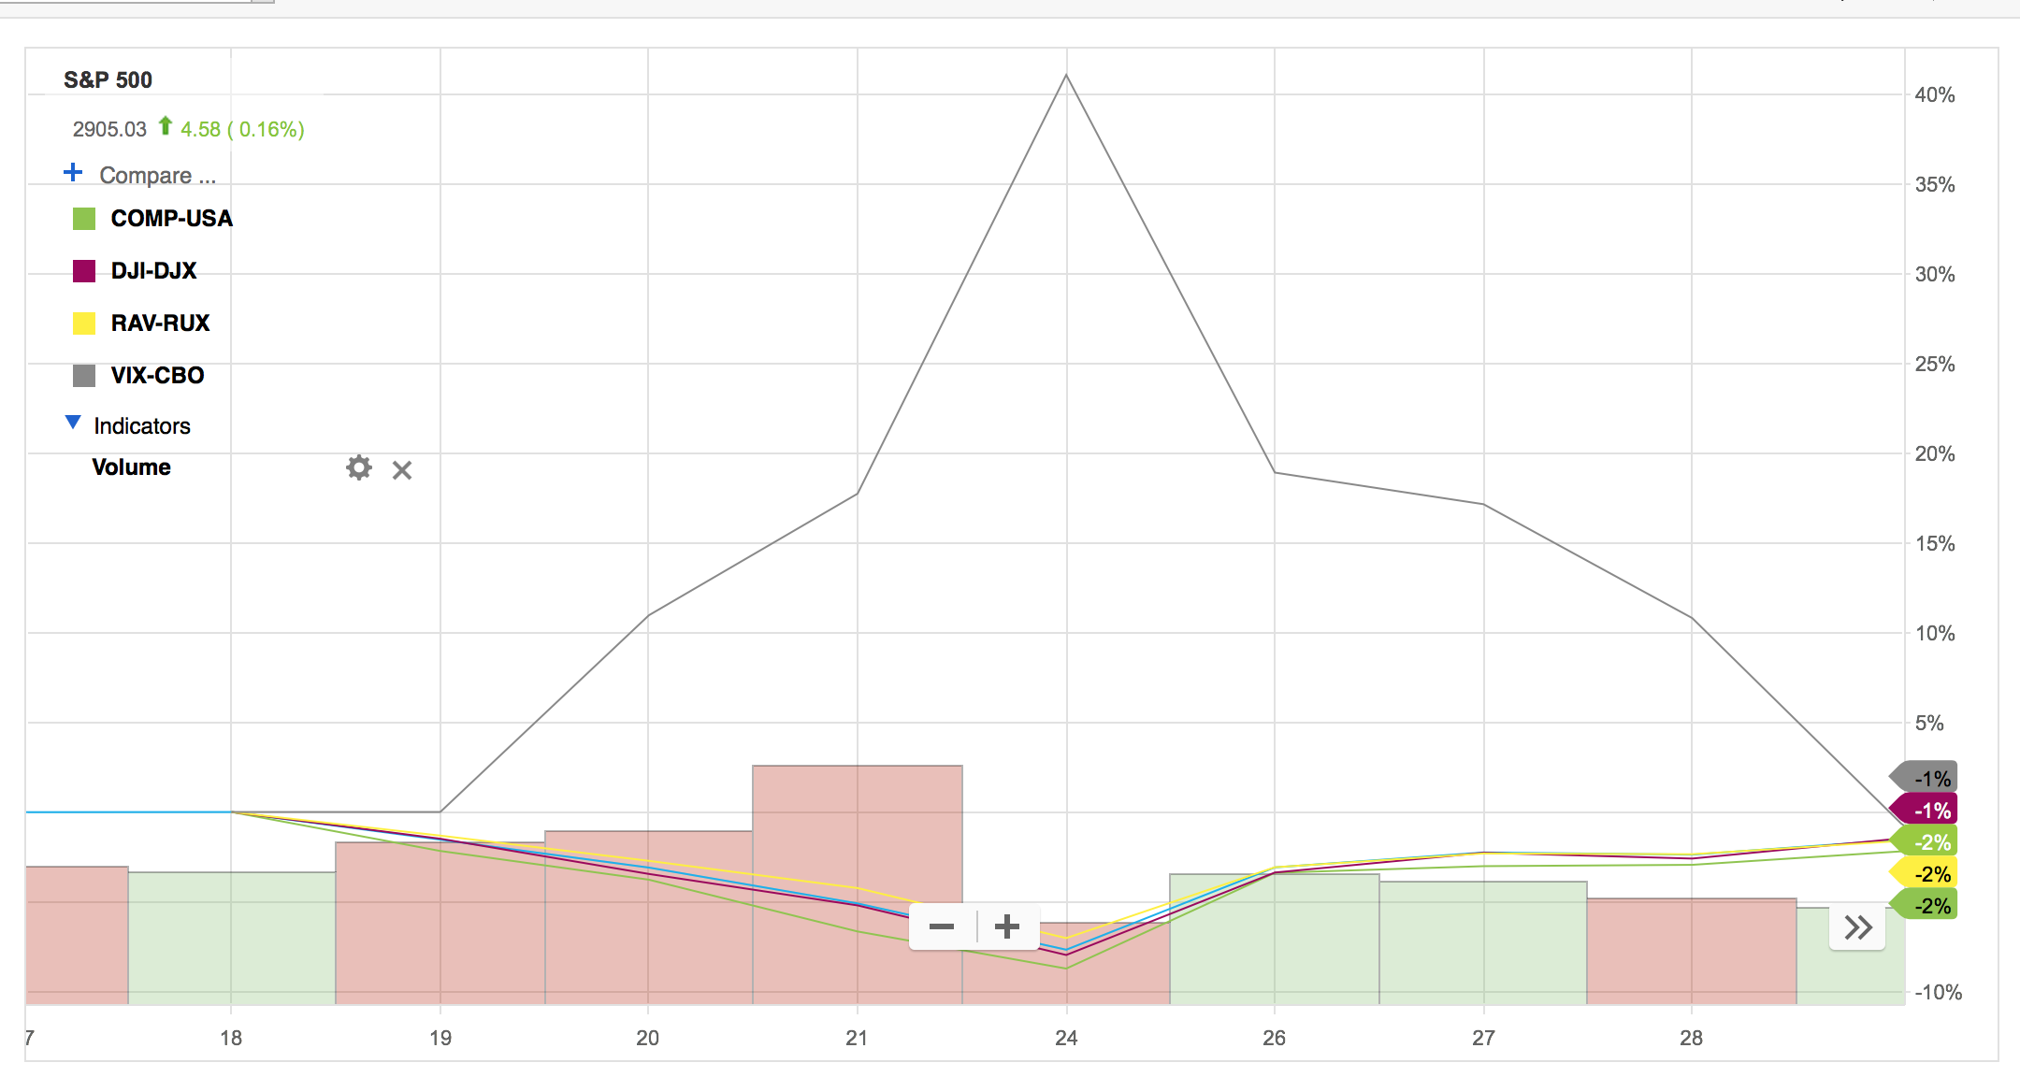
CNBC Article
https://www.cnbc.com/2019/04/10/stock-market-wall-street-in-focus-amid-inflation-data-fed-minutes.html
Last time Funds Rate was raised was on December 19th

Slide 9
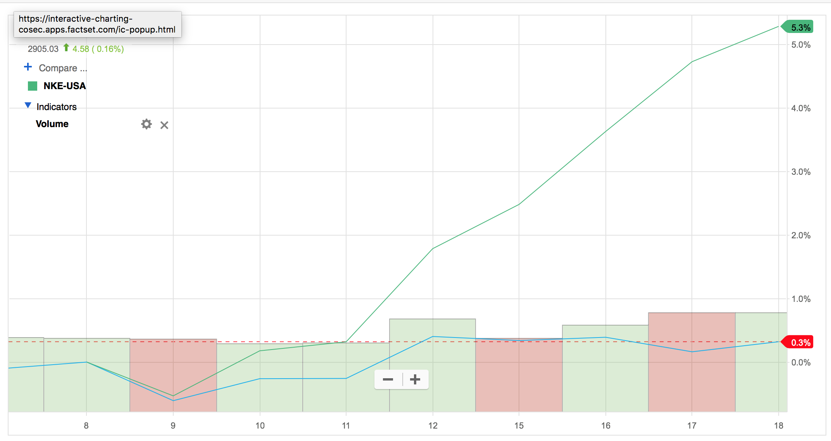
CNBC Article
https://www.cnbc.com/2019/04/15/pga-championship-what-tiger-woods-win-in-2019-masters-means-for-nike.html?__twitter_impression=true&recirc=taboolainternal

Slide 10
Thank you

